Slide 1
Part IV
Decision making and looping statement

Slide 2
Decision making
Decision making structures have one or more conditions to be evaluated or tested by the program, along with a statement or statements that are to be executed if the condition is determined to be true, and optionally, other statements to be executed if the condition is determined to be false.
If … else
Switch

Slide 3
Syntax
If statement:
if(Boolean_expression)
{
//Statements will execute if the Boolean expression is true
}
Switch statement
switch(expression)
{
case value :
//Statements
break; //optional
case value :
//Statements
break; //optional
//You can have any number of case statements.
default : //Optional
//Statements
}

Slide 4
Examples
1. Write a java method that accepts a number and checks whether the given number is even or odd using an IF statement. Demonstrate this program.
Method name: checkEvenOdd
Parameter: number … type= int
Return type: void

Slide 5
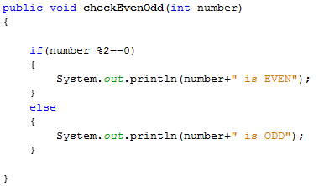

Slide 6
Cont’d
2. Write a java method that can accept the grade letter as a parameter and the following message accordingly using SWITCH statement. Demonstrate this program.
Grade=A….. Excellent
Grade=B …Good
Grade=C … You Passed
Grade=D… Failed
Other … Invalid grade
Method name: checkGrade
Parameter: grade … type=char
Return type = void

Slide 7
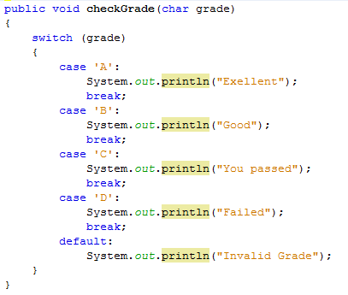

Slide 8
Loop Control
There may be a situation when you need to execute a block of code several number of times.
A loop statement allows us to execute a statement or group of statements multiple times.
While loop
For loop
Do…while loop

Slide 9
While loop
Repeatedly executes a target statement as long as a given condition is true.
Syntax
while (Boolean_expression)
{
//Statements
}

Slide 10
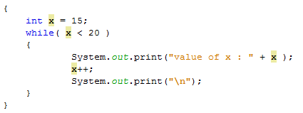
Example

Slide 11
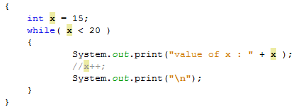
Cont’d

Slide 12
Examples
3. Write a java method that calculates a factorial of a number. The method should take a number as a parameter and return the factorial of a number using WHILE loop. Demonstrate this program.
Method Name: factorialWhile
Parameter: number … type: int
Return type: int

Slide 13
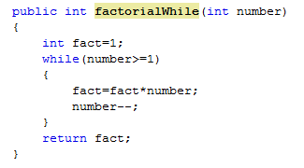
Cont’d

Slide 14
For loop
Syntax
for(initialization; Boolean_expression; update)
{
//Statements
}

Slide 15
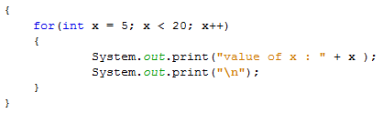
Example

Slide 16
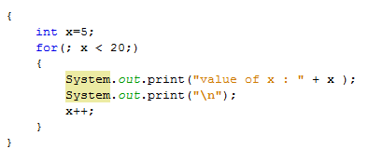

Slide 17
Examples
4. Write a java method that calculates a factorial of a number. The method should take a number as a parameter and return the factorial of a number using FOR loop. Demonstrate this program.
Method Name: factorialFor
Parameter: number … type: int
Return type: int

Slide 18
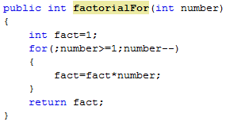
Cont’d

Slide 19
Do…while loop
A do...while loop is guaranteed to execute at least one time.
Syntax
do
{
//Statements
}while(Boolean_expression);

Slide 20
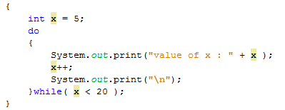
Examples

Slide 21
Examples
5. Write a java method that calculates a factorial of a number. The method should take a number as a parameter and return the factorial of a number using DO…WHILE loop. Demonstrate this program.
Method Name: factorialDoWhile
Parameter: number … type: int
Return type: int

Slide 22
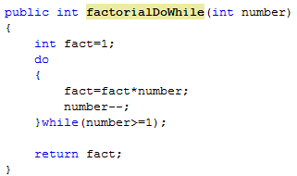
Cont’d

Slide 23
Assignment II

Slide 24
Question No.1:
The process of finding the largest value (i.e., the maximum of a group of values) is used frequently in computer applications. For example, a program that determines the winner of a sales contest would input the number of units sold by each salesperson. The salesperson who sells the most units wins the contest.
Write two java methods, one for accepting 5 sales values and other for finding the largest value.
Demonstrate the program

Slide 25

Question No.2:
Write an application that prompts the user to enter the size of the side of a square, then displays a hollow square of that size made of asterisks. Your program should work for squares of all side lengths between 1 and 20.
Use two methods for accepting the size and drawing the square.
Sample output
Enter the size= 5

Slide 26
File I/O In Java
Taking inputs using BufferedReader Class
Importing important file
import java.io.BufferedReader;
import java.io.IOException;
import java.io.InputStreamReader;
The next thing you need to do is to create an object from the BufferReader class. To create a new BufferReader object the code is this:
BufferedReader userinput = new BufferedReader (new InputStreamReader(System.in));
To get the user input, you can call into action one of the many methods available to your new Scanner object. One of these methods is called readLine. This reads a line of text.
String name = userinput.readLine( );

Slide 27
Cont’d
… = userinput.read( );
It reads a character of text. Since it returns an integer value, it needs to be explicitly casted as char for reading the content of file.
Char mychar = (char)userinput.read( );
int myint= Integer.parseInteger(userinput.readLine());
float myfloat=Float.parseFloat(userinput.readLine());
Double mydouble=Double.parseDouble(userinput.readLine());

Slide 28
Cont’d
Examples for reading a number from keyboard using buffer reader class
BufferedReader read= new BufferedReader(new InputStreamReader(System.in));
try
{
int abe= Integer.parseInteger(read.readLine());
}
catch (IOException e)
{
}

